Slide 1
KAYENTA CHAPTER
Budget Public Hearing
TUESDAY, JULY 7, 2026
1ST SESSION- 10:00 AM
2ND SESSION: 1:00 PM
3RD SESSON: 5:00 PM

Slide 2
FY2027 Budget Instructions Manual (BIM)
Approved by the Navajo Nation Budget and Finance Committee
The BIM will provide instructions on budget development, provide timelines, and planning base amounts
The Office of the Controller will submit a projected revenue

Slide 3
Navajo Nation
FY2027 Planning Base Amounts

Slide 4
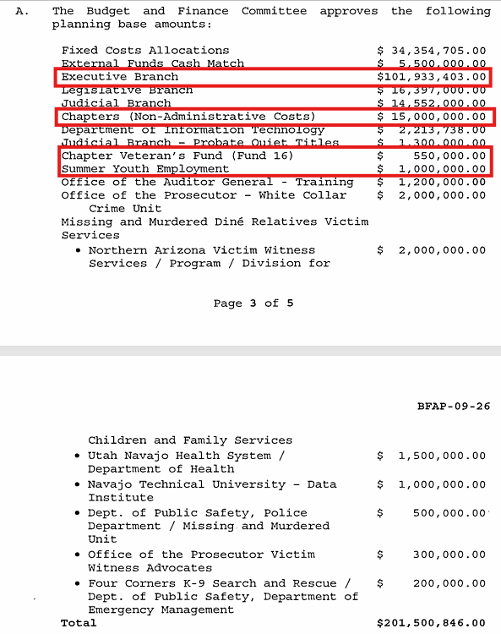

Slide 5
Navajo Nation 50/50 Formula
The 50/50 formula requires that half of the total amount be distributed evenly among the 110 chapters.
The other half would be distributed to the chapters based on the number of registered voters in each of the 110 chapters

Slide 6
Title 26-Navajo Nation Local Governance Act
Chapter 2
§ 2003. Chapter Accounting System: Chapter Appropriation; Budget Process; Chapter Insurance
C. Budget Process
  1. At least one month before the end of the Navajo Nation fiscal year, the manager, in consultation with the chapter officials, shall prepare, schedule, and explain the annual chapter budget to the membership. Chapters are required to follow the annual budget instruction of the Navajo Nation Office of Management and Budget when formulating the annual Chapter budget and when the budget concerns Navajo general funds.

Slide 7
Five Management System-Fiscal Policy
VI. Kayenta Chapter Operating Budget
C. Budget Preparation and Procedures:
  1. Upon notification of the Kayenta Chapter’s base allocation from the Navajo Nation, the Kayenta Manager, in consultation with the Kayenta Chapter Officials, shall review and follow the budget instruction manual of the Navajo Nation of Management and Budget (OMB) when formulating the annual budget.
  4. The Kayenta Chapter Manager, in consultation with the Kayenta Chapter Officials, shall prepare a proposed budget and schedule a public meeting to obtain input on the proposed budget from the Kayenta Chapter membership (which may be a duly-called regular Kayenta Chapter meeting).

Slide 8
PLANNING FOR THE CHAPTER BUDGET
Title 26
Kayenta Chapter Five Management System
Navajo Nation Budget Instruction Manual
Kayenta chapter policies and procedures
Kayenta chapter fund management plan

Slide 9
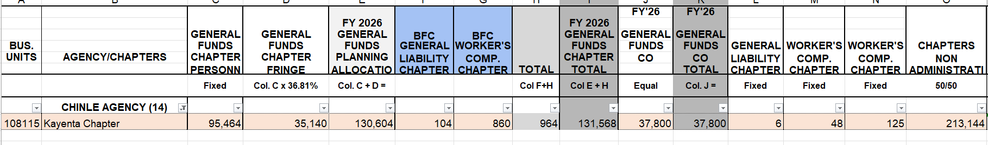
FY2026 Budget Allocation
FUND 09/10/13/15
FUND 02
FUND 02
FUND 02
FUND 12
FUND 02
FUND 02
FUND 12

Slide 10
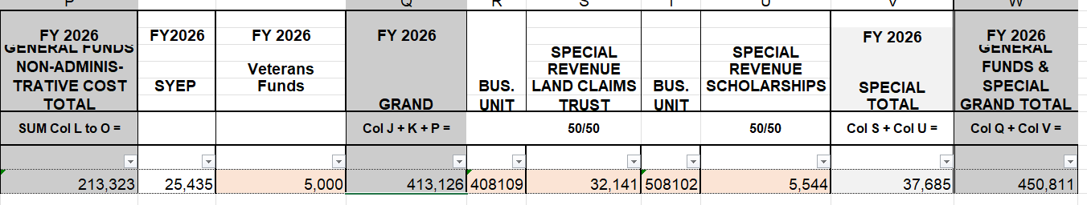
FY2026 Budget Allocation continuation
FUND 08
FUND 16
FUND 03
FUND 14

Slide 11
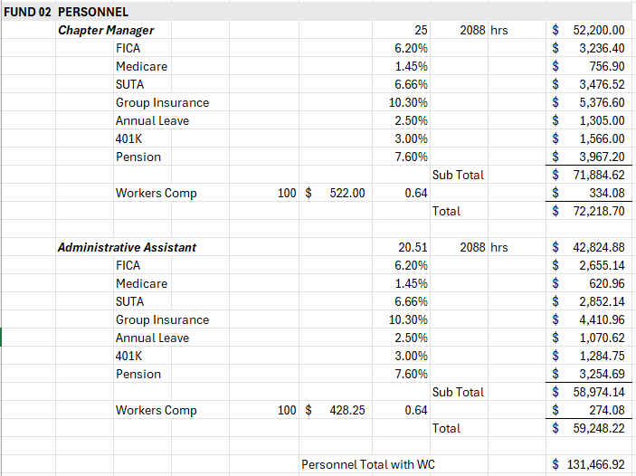
FY 2027:PROPOSED BUDGET: FUND 02-PERSONNEL

Slide 12
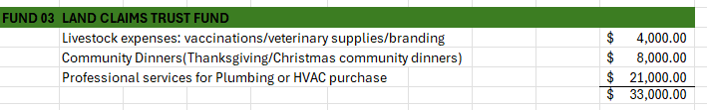
FY 2027 PROPOSED BUDGET:
FUND 03- LAND CLAIMS TRUST FUND

Slide 13

FY 2027 PROPOSED BUDGET:
FUND 14- SPECIAL CLAIMS- STUDENT FINANCIAL ASSISTANCE

Slide 14
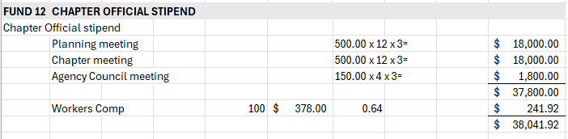
FY 2027 PROPOSED BUDGET:
FUND 12- CHAPTER OFFICIAL STIPEND

Slide 15
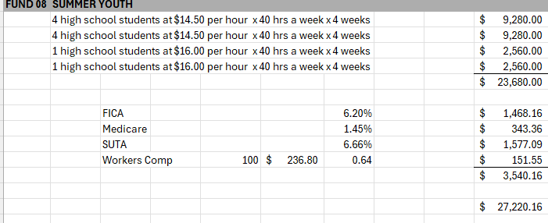
FY 2027 PROPOSED BUDGET:
FUND 08-SYEP

Slide 16

FY2027 PROPOSED BUDGET: FUND 16-VETERANS

Slide 17
NON-ADMINISTRATIVE COSTS:
FUND 09-HOUSING DISCRETIONARY FUND
FUND 10- LGA GRANT FUND
FUND 13- SCHOLARSHIP
FUND 15-PUBLIC EMPLOYMENT PROGRAM

Slide 18
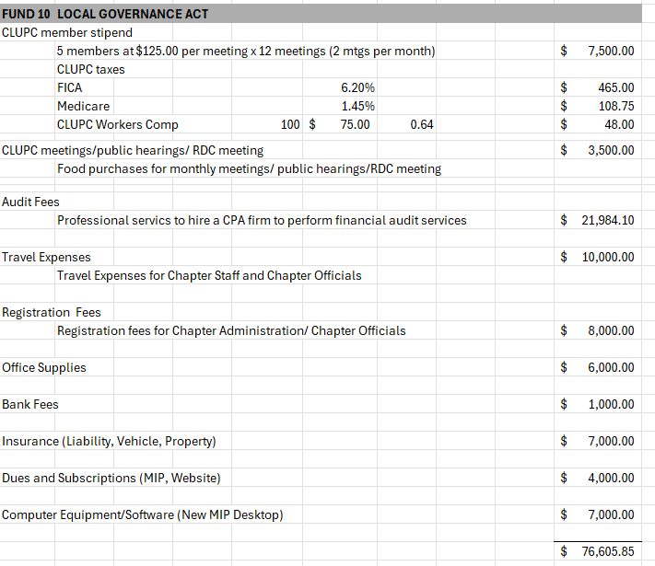
FY 2027 PROPOSED BUDGET: FUND 10-LGA GRANT FUND

Slide 19
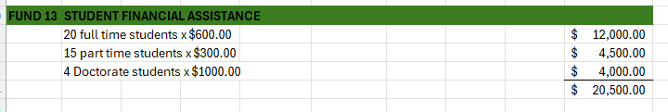
FY 2027 PROPOSED BUDGET:
FUND 13- SCHOLARSHIP

Slide 20
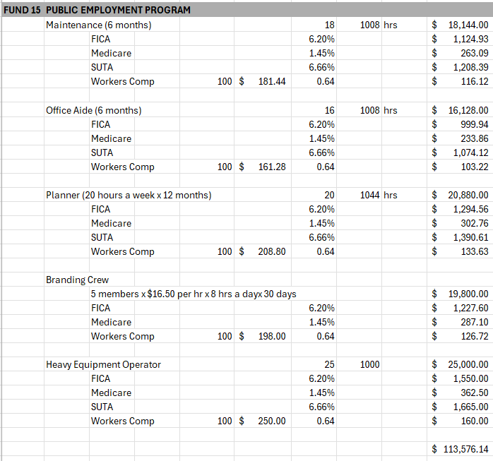
FY 2027 PROPOSED BUDGET:
FUND 15- PUBLIC EMPLOYMENT PROGRAM

Slide 21
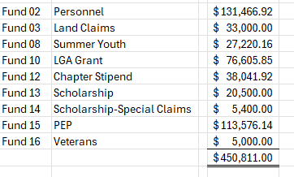
FY2027 PROPOSED BUDGET

